Slide 1

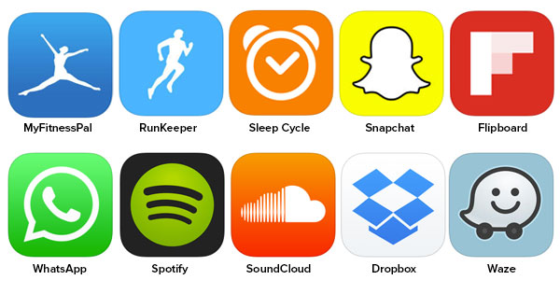
Title -“REVENUE PREDICTION MODEL FOR PAID AND UNPAID APPS ON PLAYSTORE”
by Mr. Sahitya Setu

Slide 2
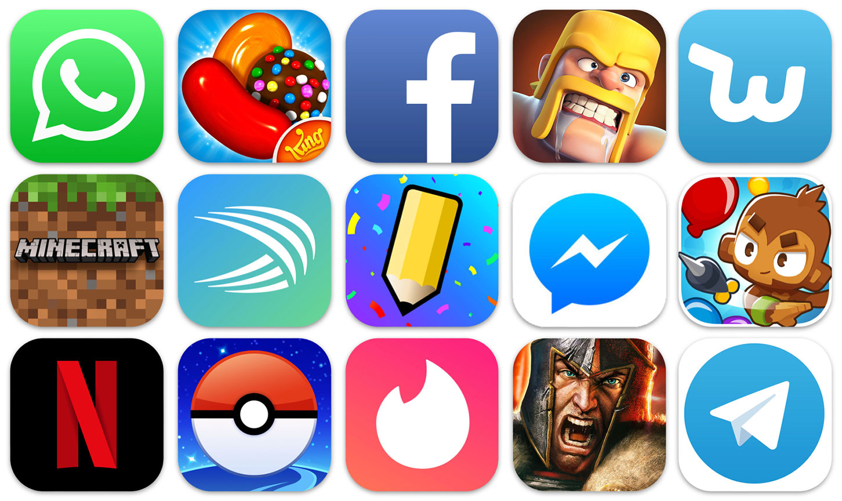
Problem statement :-
A developer's best friend is mobile app analytics. They allow you to understand how the actions and application of your users can be tailored to achieve your goals. Without mobile app analytics, without any evidence to back up your tests, you can blindly try out various things. That's why knowing their mobile app analytics is incredibly important for developers to be able to monitor their success when working toward achieving their goals.
Companies or developers are not sure which category of apps to target or what should be the app size for an app, the relationship between app ratings to revenue or which revenue model will fetch what numbers to be successful financially or to be profitable on the app. Data analysis of apps can give us these crucial insights.

Slide 3
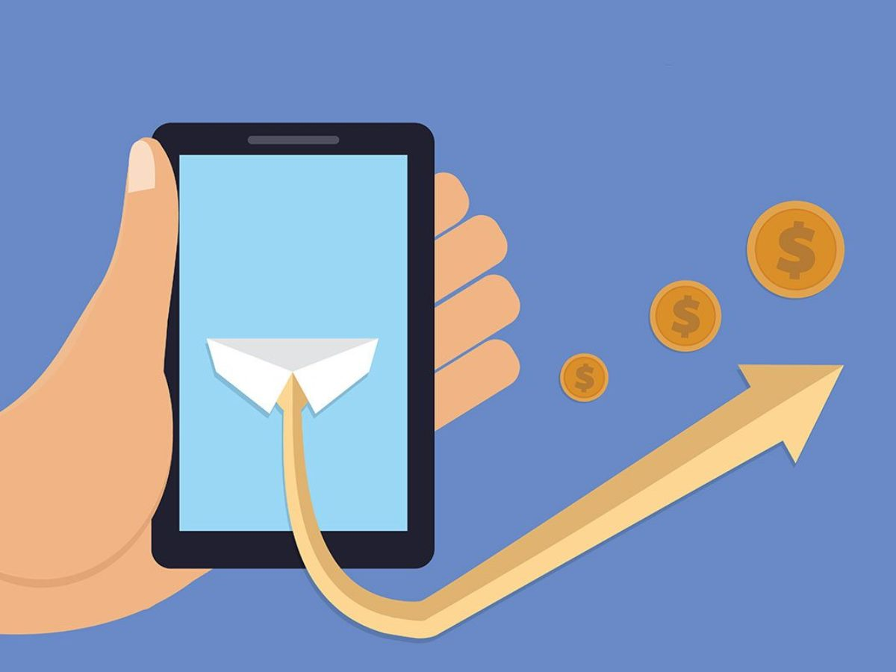
Literature Review
Different revenue models of smartphone apps:-
Free, But (In-App Advertising)
This is a variant on your smartphone you've probably seen often in the games. You eliminate the cost-barrier for buying your app in this business model and encourage free downloads. Your aim is to accumulate a broad user base and collect data about the people who communicate with your app. This information is then sorted and sold to app publishers who pay you to put targeted advertising on your app.
Freemium (Locked Features)
In a freemium business model, the app is often delivered free of charge, similar to in-app ads, but some functions are gated and cost money to be unlocked. In other words, people have access to the basic functionality of an app, but premium or proprietary features are subject to a fee. This model's idea is to draw users to your app and give them a rich glimpse of what your app can do (without giving them everything). The aim is to accumulate and engage users of apps before they are prepared to pay for additional in-app resources.
Paid Apps (Pay Money to Download)
The business model of a paid app basically means that your app is not free to download. If people want to use your app, they have to buy it from the app store first
In-App Transactions (Physical/Virtual Goods Sales)
In-app transactions are what they sound exactly like. In a nutshell, this technique of app monetization includes selling inside the app physical or virtual products and then keeping the profits. In-app purchases, such as clothing and shoes, may include a wide range of consumer products. However, virtual items such as extra life or in-game money can also be in-app purchases.

Slide 4
Business Understanding -
Business Understanding
Data understanding
Data preparation
Modelling
Evaluation
Business problem that I am trying to solve –
Q ) which Category should I make an App for as a company to make the maximum Revenue ?
Q) Which Category will give me the highest paid revenue i.e. Price* Downloads ?
Q) If I launch a free to download app which Category I should focus on for maximum Advertisement income ?
Q)What are the important factors for making more revenue in any given Category ?
Q) What is the minimum android capacity should an app has to make max revenue ?
Q)What are the factors which lead to more revenue for those app which are only supported by Advertisements ?

Slide 5
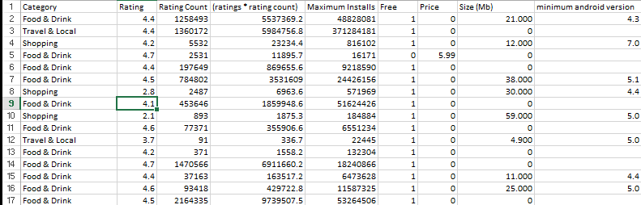
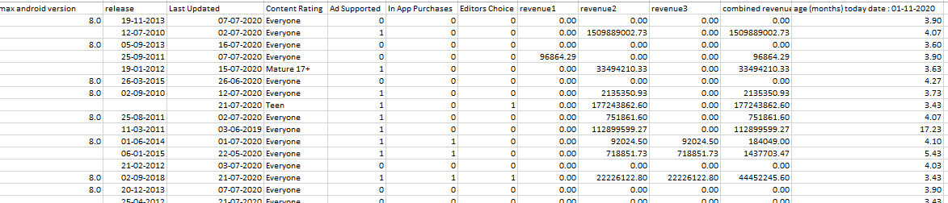
Data snapshot

Slide 6
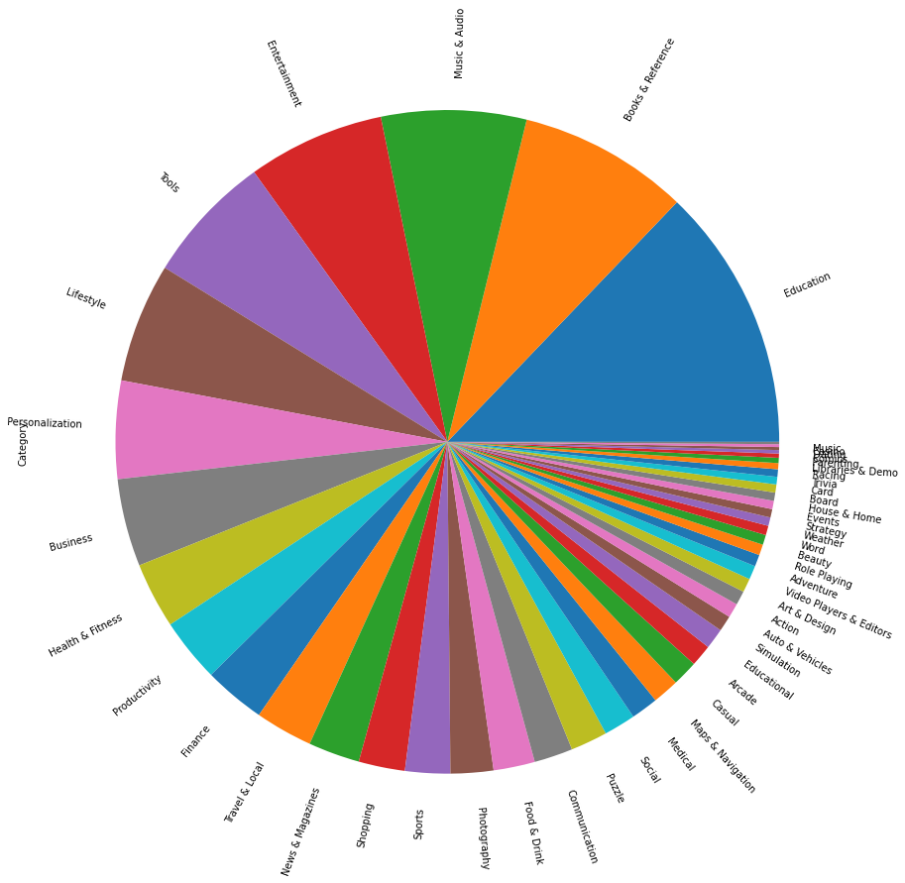
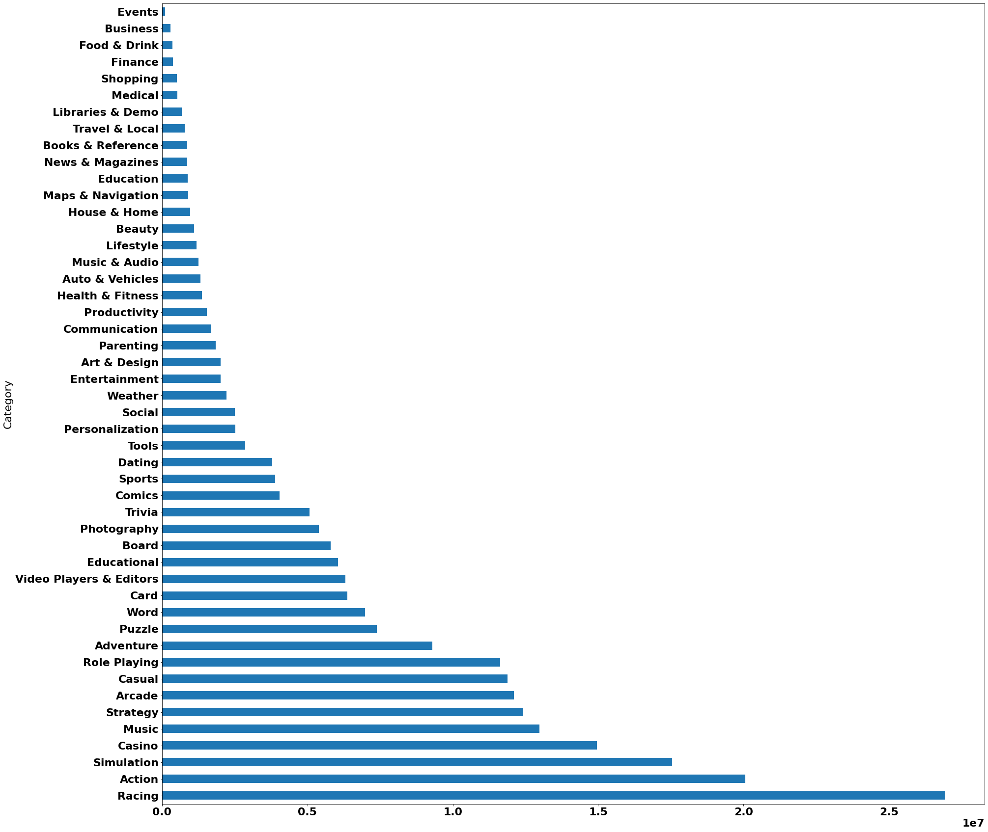
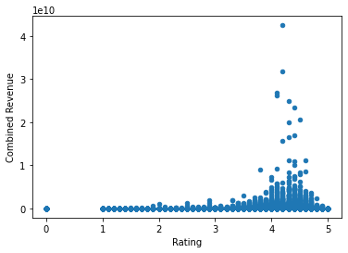
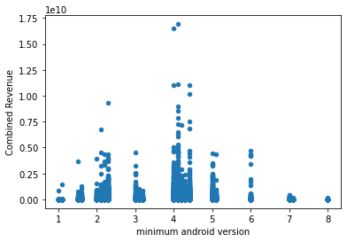
Data Understanding
Done through EDA in python , Pandas Profiling , Excel Dashboard
Correlations between different Factors
Category Analysis

Slide 7
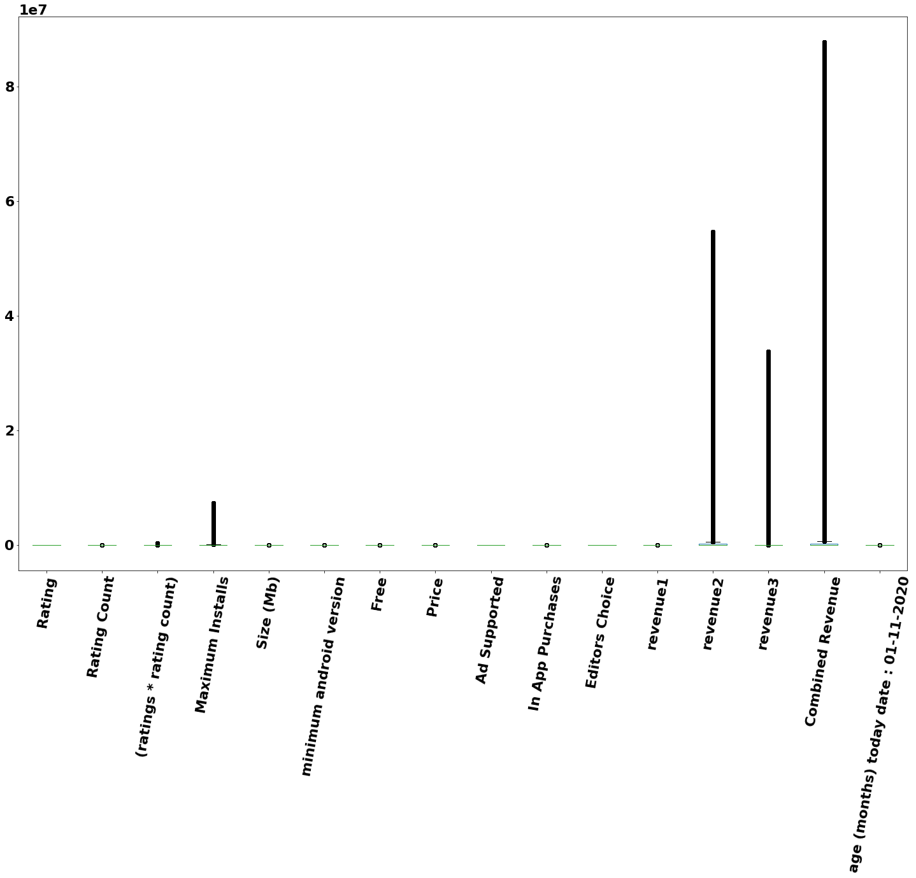
Data Preparation
Cleaning of Data
Standardization of certain columns
Adding new columns based on raw data
Data pre processing
No duplicate rows
Missing values small fraction- removed
Outliers removed before putting into
Regression models
revenue1 | Float | App price * Dowloads
revenue2 | Float | If In Advertisements is True : ( 1$ * Downloads * Age)
revenue3 | Float | If In Purchases is True : ( 1$ * Downloads * Age)
Combined Revenue | Float | Revenue1 + revenue2 + revenue3
Age | Float | In months unit (Today’s Date – Last Updated ) Today’s Date taken :01-11-2020
Ratings * Rating count | Float | Weighted average of Ratings and Ratings count

Slide 8
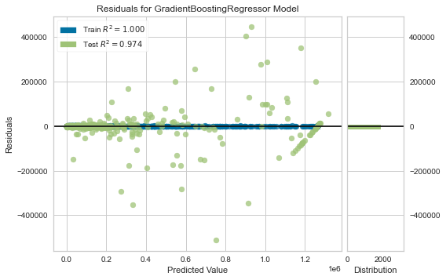
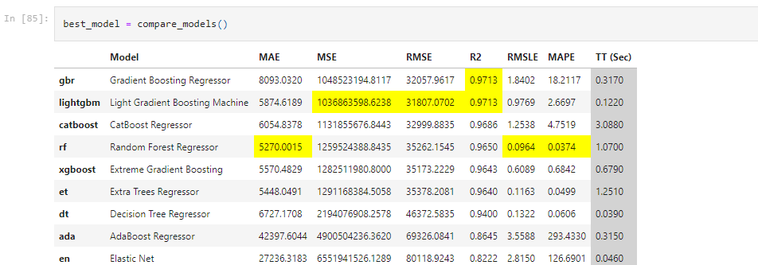
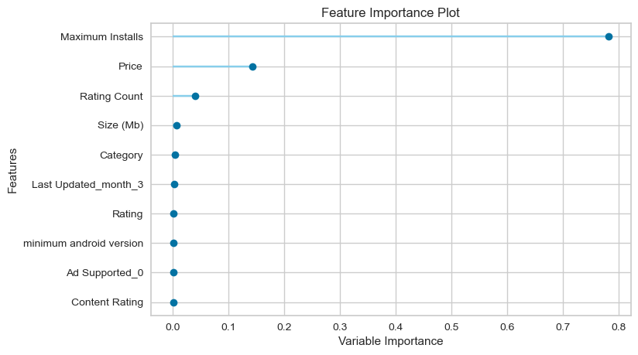
Modelling – Regression
Use of PyCaret library to get the regression model with best prediction power

Slide 9




Revenue 1 model
Revenue 2 model
Revenue 3 model
Combined revenue model

Slide 10
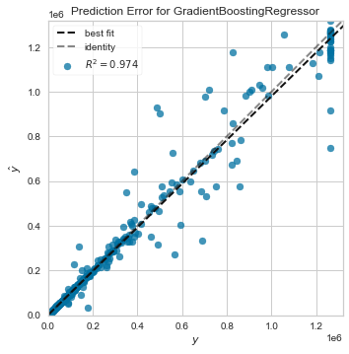
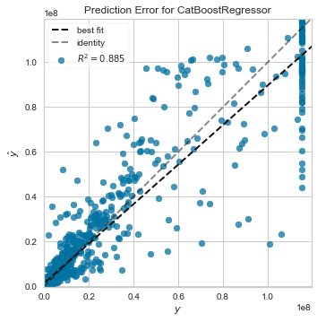
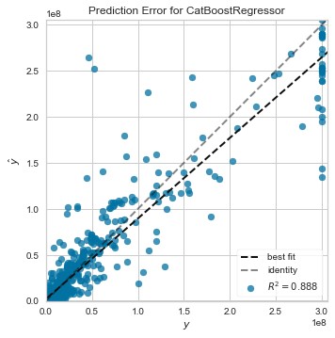
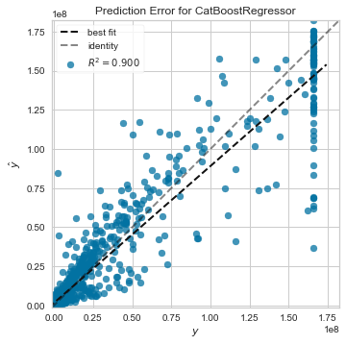
Evaluation-Validation-Testing

Slide 11
Findings & Conclusion
Q ) which Category should I make an App for as a company to make the maximum Revenue ?
Ans - Racing Games Apps
Q) Which Category will give me the highest paid revenue i.e. Price* Downloads ?
Ans - Adventure
Q) If I launch a free to download app which Category I should focus on for maximum Advertisement income ?
Ans- Action
Q)What are the important factors for making more revenue in any given Category ?
Ans- Maximum Installs , Minimum Android version , Rating Count
Q) What is the minimum android capacity should an app has to make max revenue ?
Ans - 4.0 and Up is sufficient
Q)What are the factors which lead to more revenue for those app which are only supported by Advertisements ?
Ans - Maximum Installs , Minimum Android version , ratings* ratings count , size , Category

Slide 12
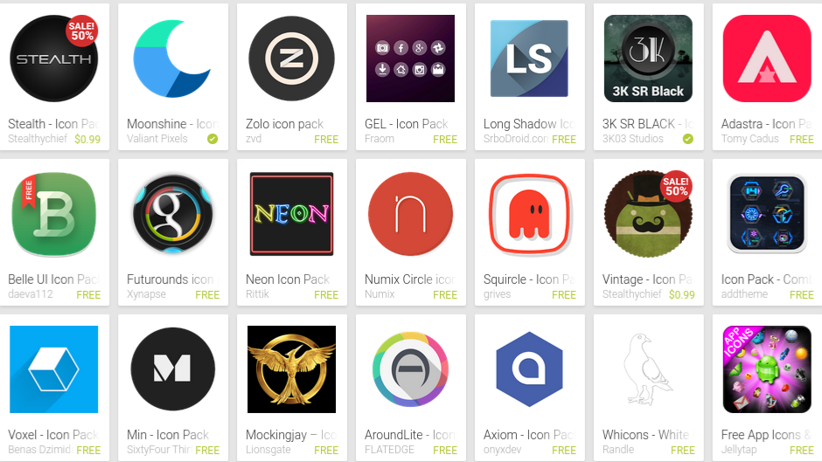
From the findings, we can say that the number of downloads for an app is a key driver to generate revenue and so companies should try to push it. The companies should also consider the android version support while developing an app in the app development cycle to find the optimum level where it is gives the most returns. The count of total ratings is also a good indicator of the revenue and monetary value for an app.
The most popular Categories would be valid through at least a year and App development companies can target those Categories also considering the app development cost to maximize profits.
Gaming apps are most profitable and in particular racing games apps. For paid apps Adventure is the most profitable genre. ‘4.0+’ minimum android version support brings most revenue. Number of ratings is positively correlated with revenue from pay to download apps.

Slide 13

Recommendations
Companies should push for more downloads instead of more price on the app.
Racing is the most revenue generating category in gaming space so it can be focused on by gaming app companies.
The companies should also target the number of ratings given count as it is a good indicator of app revenue performance.
Android version Support is also significantly co-related to all the revenue sources and hence a company should give it importance in development.
An app rating between 4 to 5 is the most ideal to get more revenue.

